Slide 1
Coding Standards
Effective Not Just Efficient

Slide 2
Coding Standards
Abstract
Every project has a development standard.
Sometimes the standard is “if it was hard to write, it should be hard to maintain.”
Developing, and following, a corporate Best Practices standard will lead to continuity, maintainability, robustness, and pride.

Slide 3
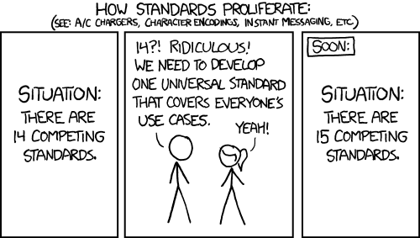
How Coding Standards Proliferated
Drumroll

Slide 4
Coding Standards (Best Practices) in a Nutshell
Similar to writing in accordance with APA or MLA
Allows people to focus on content, not formatting
Source: 2015, Drupal Coding Standards, Joe Shindelar http://www.pluralsight.com/courses/drupal-coding-standards

Slide 5

Wars have been fought … Lives have been lost
tabs
{ }
switch
comments
versioning
…
indention

Slide 6
Why Practice these Coding Standards?
 | Regression Testing | Maintain | Support | Reuse | Deploy
N-Tier | ✓ | ✓ | ✓ | ✓ | ✓
Unit and Integration Testing | ✓ |  | ✓ | ✓
Extension Methods |  | ✓ | ✓ | ✓
Dependency Injection |  | ✓ | ✓ | ✓
Coding Standards |  | ✓ | ✓ | ✓ | ✓
Peer Review | ✓ | ✓ | ✓ | ✓
Recognized Patterns |  | ✓ | ✓ | ✓

Slide 7
Justification for Coding Standards: Simple Answer
Coding Standards Make Software:
Coding Standards Make Products:
Safe
can be used without causing harm
Secure
can’t be hacked
Reliable
functions as it should, every time
Testable
can be tested at the code level
Maintainable
can be maintained, even as your codebase grows
Portable
works the same in every environment
Compliant
with industry standards
Consistent
with corporate products and offerings
Secure
from the start
Economic
to developed
Accelerated
time to market
Source: 2019, Coding Standards For Quality and Compliance, Perforce https://www.perforce.com/resources/qac/coding-standards

Slide 8

Life without Coding Standards
Theiyr’re
Source: Mark Reynolds, compilation

Slide 9
Coding Standards: Definition
Coding Standards ARE:
Coding Standards Address:
A set of guidelines
for a specific programming language
for programming styles, practices, and methods
for software structural quality
Applicable to the human maintainers and peer reviewers
May [should] be formalized and followed by an entire team or company
Not enforced by compilers
file organization
indentation
comments
declarations
statements
white space
naming conventions
programming practices
programming principles
programming rules of thumb
architectural best practices, etc.

Slide 10
Coding Standards: Principals and Patterns to Live By
Fundamental Principals
Common Design Patterns
SOLID
Single-responsibility Principle
Open-closed Principle
Liskov substitution principle
Interface segregation principle
Dependency Inversion principle
DRY
Don’t Repeat Yourself
YAGNI
Ya Ain’t Gonna Need It
Singleton
Factory
Iterator
Abstract
CQRS
IOC / DI

Slide 11
Starter Set of Design Patterns
Factory
Abstract and Derived class
Implementation of Methods Deferred
Observer
Gaining popularity with WPF / MVVM
Permits Inversion through Class Updates
Repository
Encourages Inversion of Control and Mocking
Strategy
Interchangeable family of algorithms
Singleton
The JarJar Binks of SW Design Patterns
Suggestions
Similar to Factory, but chosen at Run-time
?
?

Slide 12
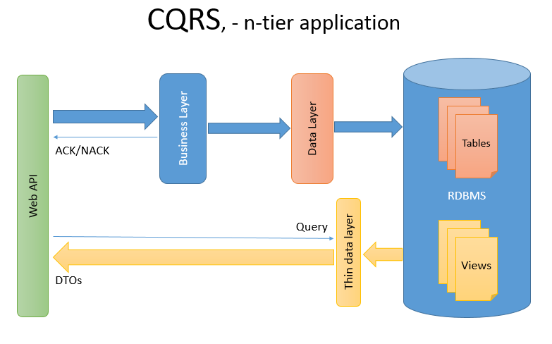
CQRS – Command Query Response Service

Slide 13
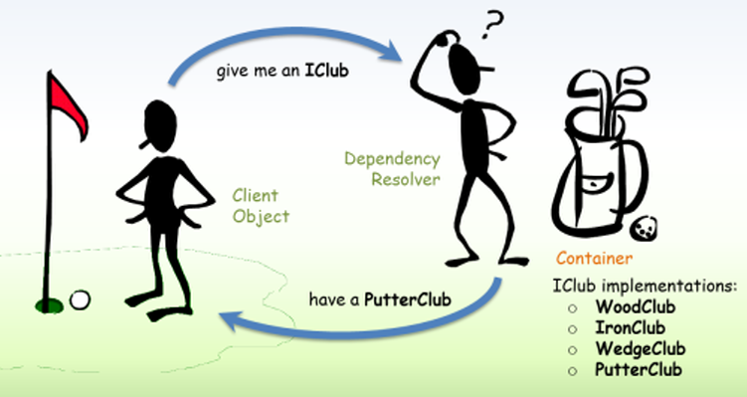
DI / IOC – Dependency Injection / Inversion of Control

Slide 14
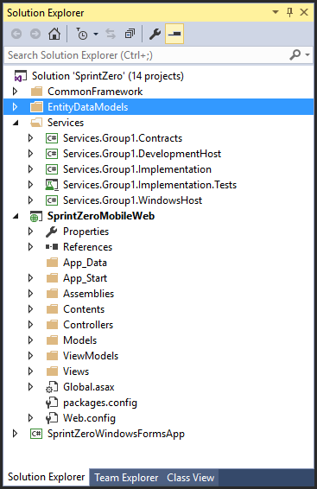
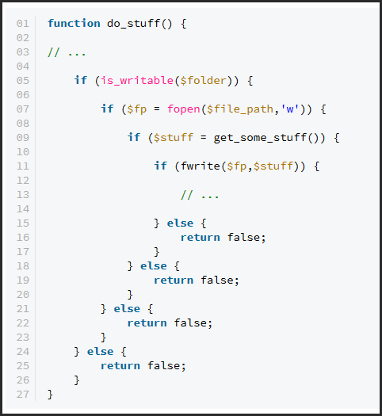
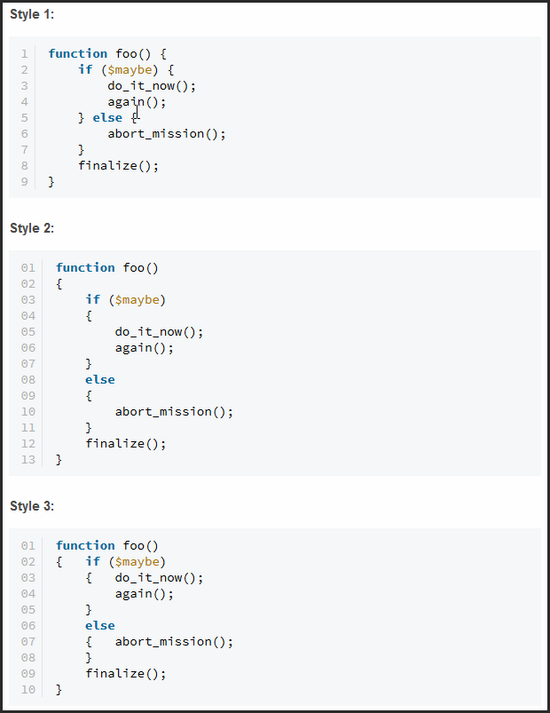
Coding Standards: Code Stability and Robustness
Top 15 Best Practices
Commenting & Documentation
Consistent Indentation
Avoid Obvious Comments
Code Grouping
Consistent Naming Scheme
SOLID / DRY / YAGNI Principles
Avoid Deep Nesting
Limit Line Length
File and Folder Organization
Capitalize SQL Special Words
Consistent Temporary Names
Capitalize SQL Special Words
…
Separation of Code and Data
Alternate Syntax Inside Templates
Object Oriented vs. Procedural
Read Open Source Code
Source: 2011, Top 15+ Best Practices for Writing Super Readable Code, Burak Guzel http://code.tutsplus.com/tutorials/top-15-best-practices-for-writing-super-readable-code--net-8118
Notes:
DRY = Don’t repeat Yourself
Hard limit line lengths can be … mean

Slide 15
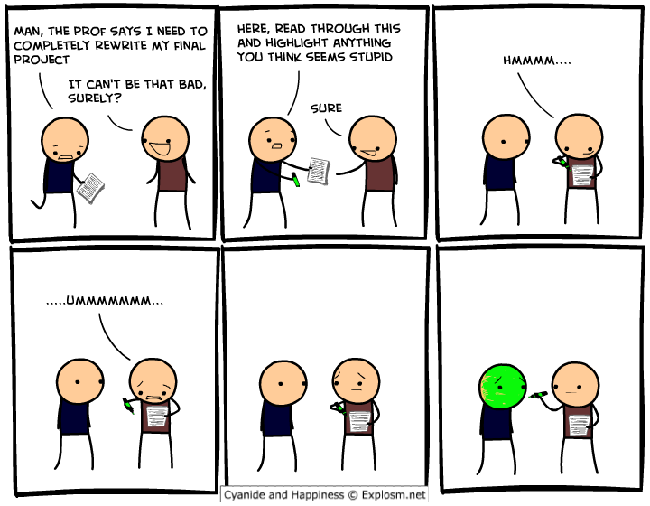
Coding Standards: Peer Review?
Wait for it…
Source: 2013, The Truth About Code Review II, David Walsh http://davidwalsh.name/code-review-2

Slide 16
Coding Standards: Naming Convention
Trace a variable from source to grave
Column in database: Flymm_Flam
Property in ORM class: Flymm_Flam ( or FlymmFlam ? )
Represented a local variable: flymmFlam
Class-Private field: _flymmFlam
Constant: FLYMM_FLAM ( avoid constants )
Controls: btnFlymmFlam ( no consensus )
Method parameter: flymmFlam
Source: Mark Reynolds, compilation
Notes:
Note: constants in test projects are a typically good

Slide 17
Coding Standards: More Naming Standards
DO NOT use single letter variable – spell out the purpose
Be environment aware – DO NOT use reserved words
Avoid abbreviations
Use lastName, not nam
Unless they are well known like Xml, Html or IO
DO NOT vary variables by case! (C#)
Be consistent !!!
Source: 2012, .NET Coding Standards For The Real World , David McCarter http://www.slideshare.net/dotNetDave/net-coding-standards-for-the-real-world

Slide 18
Coding Standards: When should a file be created?
One class per file
Exception: request / response classes in CQRS
Exception: enums?
File name = class name

Slide 19
Coding Standards: What’s in a Namespace?
Name Space Hierarchy (no consensus)
CommonFramework.Core.Extensions
CommonFramework.Core.Tests
DataEntities.NorthWind
DataEntities.NorthWind.Tests
Services.Accounts
Services.Accounts.Contracts
Services.Accounts.Implementation
Services.Accounts.Tests

Slide 20
Coding Standards: Language Specification vs System Classes
Use language value types, not system extensions
Use int, long, string, char
Avoid String, Int32, Char
Use var whenever possible
(Others recommend only used when obvious on the right side)

Slide 21
Declaring Variables / Instantiating Variables
Consider:
class randomClass
{
IEnumerable<MyClass> _myCollection;
void randomMethod()
{
_myCollection = new List<MyClass>();
var tempInstance = new List<myClass>();
...

Slide 22
Coding Standards: Using the using
Header using statements
Body using statements
When you need clear annunciation
use full namespace reference
omit the using in the header
When using common C# / .NET references
minimize namespace reference
Include the using in the header
When there is ambiguity
use enough namespace reference
To aid in GC
Especially connection objects
Requires IDisposable
To aid in readability
Source: Mark Reynolds, compilation

Slide 23
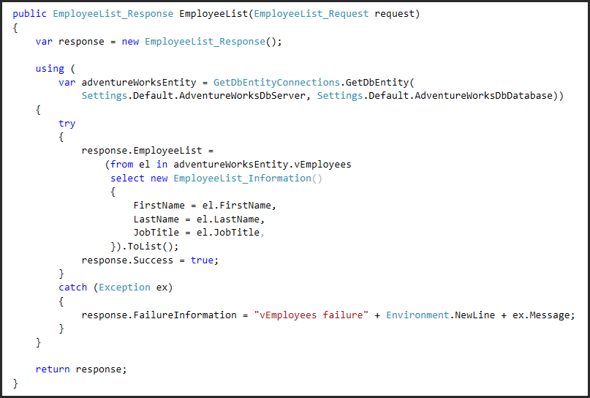
Coding Standards: Using the using

Slide 24
Coding Standards: Classes
Constructor
Do not call code / methods from within (no consensus)
Parameter capture only
No exposed variables
Use public (or protected) properties
Permits validation processes
Permits events
Group uniformly and logically
Class-level fields immediately before / after the constructor(s)
IDisposable methods at end (collapsed via a #region?)
UI event controls above other methods
Source: Mark Reynolds, compilation

Slide 25
Coding Standards: Maintainability
Refactor for code reuse, low cyclomatic complexity values
If you can’t see your code on one screen in the editor, then it’s probably too long!
Keep generics in mind
There are two kinds of programmers:
Complexifiers are averse to reduction
Simplifiers thrive on concision
If your method, class etc. seems huge or overly complicated, then you are most likely doing it wrong!
Refactor!
Ask a follow programmer!
Pair programming!
Code review!
Source: 2012, .NET Coding Standards For The Real World , David McCarter http://www.slideshare.net/dotNetDave/net-coding-standards-for-the-real-world
Notes:
Concision = being concise

Slide 26
Coding Standards: Maintainability
Comment your logic in the code
Be through
Keep it short
Make the code speak for itself
Mark changes
Date / time
Author
Change # / bug #
Absolutely make the // TODO
Include who is responsible to complete
Include who originated the TODO
(no consensus)
Or not???
Source: Mark Reynolds, compilation

Slide 27
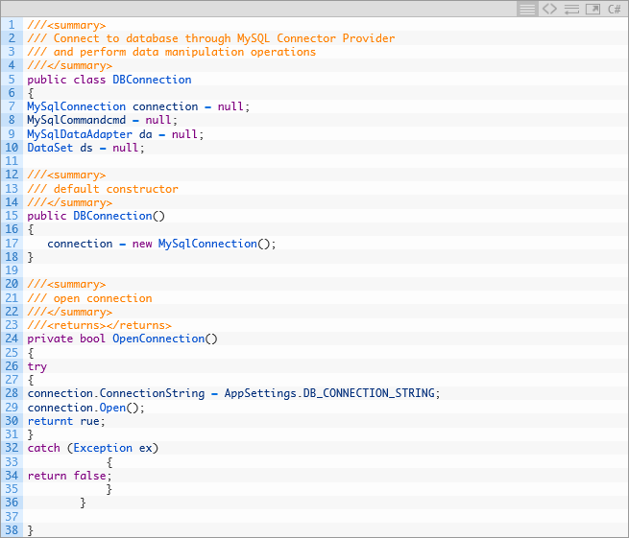
Coding Standards: Maintainability
XML Comments
Source: 2013, C# Coding Standards and Best Programming Practice Part-1 http://sharp-coders.com/microsoft-net/c-sharp/csharp-coding-standards-best-programmin-practice-part-1

Slide 28
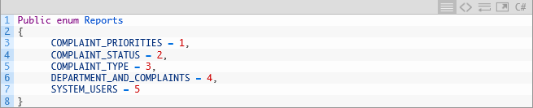
Coding Standards: Constants and Magic Numbers
Source: 2013, C# Coding Standards and Best Programming Practice Part-1 http://sharp-coders.com/microsoft-net/c-sharp/csharp-coding-standards-best-programmin-practice-part-1

Slide 29
Coding Standards: More Maintainability
Utilize the //TODO reminder
Work through warnings
Reformat class when completed
Source: Mark Reynolds, compilation

Slide 30
Coding Standards: Teams and Testing
Before you check in code
Make sure it runs
Resolve all errors
Review [fix] all warnings
Resolve all conflicts
Verify the build (continuous integration)
Source: Mark Reynolds, compilation

Slide 31
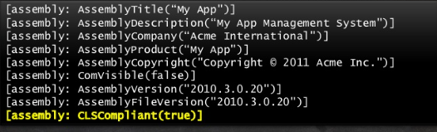
Defensive Programming: Assembly Attributes
Complete ALL Assembly Attributes
Utilize the System.CLSCompliant attribute
Check out Stack Overflow
Source: 2012, .NET Coding Standards For The Real World , David McCarter http://www.slideshare.net/dotNetDave/net-coding-standards-for-the-real-world

Slide 32
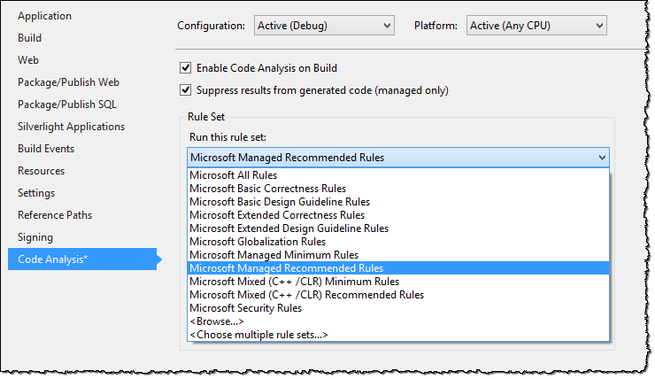
Defensive Programming: Code Analysis
Source: 2012, .NET Coding Standards For The Real World , David McCarter http://www.slideshare.net/dotNetDave/net-coding-standards-for-the-real-world

Slide 33
Coding Standards: Third party products
Tools to add to Visual Studio
ReSharper
http://www.jetbrains.com/
Refactor Pro! For Visual Studio
https://www.devexpress.com/Products/CodeRush/refactor_pro.xml
StyleCop
https://stylecop.codeplex.com/
CodeIt.Right
http://submain.com/products/codeit.right.aspx
VS Analyze or FXCop
https://msdn.microsoft.com/en-us/library/bb429476(v=vs.80).aspx
Reference Information
Design Guidelines for Class Library Developers
http://DGForClassLibrary.notlong.com
.NET Framework General Reference Naming Guidelines
http://namingguide.notlong.com
Source: Mark Reynolds, compilation

Slide 34
Coding Standards: Best Practices Become Agile Software Programming
Test-first programming (or perhaps Test-Driven Development),
Rigorous, regular refactoring,
Continuous integration,
Simple design,
Pair programming,
Sharing the codebase between all or most programmers,
A single coding standard to which all programmers adhere,
A common “war-room” style work area. (no consensus)
Source: 2015, Agile Software Programming Best Practices http://www.versionone.com/agile-101/agile-software-programming-best-practices/

Slide 35

Coding Standards: Defensive Programming
Addressing the Unknown Unknowns
There are known knowns.
These are things we know that we know.
There are known unknowns.
That is to say, there are things that we know we don't know.
But there are also unknown unknowns.
There are things we don't know we don't know.
~Donald Rumsfeld
Source: https://www.youtube.com/watch?v=GiPe1OiKQuk

Slide 36
Defensive Programming
Defensive Programming
Objectives
An approach to improve software & source code
Addresses unforeseen circumstances
Quality reduce # software bugs
Comprehensibility readable & understandable
Deterministic perform predictably despite unexpected inputs or user actions.
Source: https://en.wikipedia.org/wiki/Defensive_programming

Slide 37

Deploying without Defensive Programming
Notes:
How you feel after deploying in a pinch, taking shortcuts.

Slide 38
Do we Need / Want Defensive Programming?
Opinion #1: Defensive Programming is Rubbish
Unnecessary alternative code
Unnecessary null checks
Time, once spent, is lost
Opinion #2: Defensive Programming is Pragmatic Paranoia
Expect the unexpected
Protect against the outside
Time, once invested, is saved

Slide 39

24 hours later
Notes:
How you feel after deploying in a pinch, taking shortcuts – 24 hours later when it unravels.

Slide 40
Defensive Programming: Code Stability and Robustness
Consider failure at every juncture
Examine and handle faults that can be expected
Null values returned
Non-numeric content
Try-catch where the unplanned may exist
Data access
Foreign DLL interface
Plan to clean-up unmanaged code
Consideration of Failure Modes are one of the
most important coding standards
When considering failure modes,
when and how should a Unit Test / Integration Test be used?
Source: Mark Reynolds, compilation

Slide 41
Defensive Programming: Unit and Integration Testing
Unit Testing
Integration Testing
Starts within the Class, behind the Interface Specification
Tests small pieces of code
Tests a single component
Scope is narrow, self-contained
Should have no dependencies
Limits scope of test to a single class
Starts with the Interface Specification
Validates cross project or external interoperability
Dependent on outside systems or projects within the solution
Generally, Integration Testing will assist identifying broken external systems and interfaces

Slide 42
Defensive Programming: Code Stability and Robustness
Watch for any code that might cause an exception
accessing files
using objects
Examples:
call File.Exists to avoid a FileNotFoundException
check an object for null
check a DataSet for rows
check an Array for bounds
check String for null or empty
clean up unused objects!
All data is bad until verified
Source: 2012, .NET Coding Standards For The Real World , David McCarter http://www.slideshare.net/dotNetDave/net-coding-standards-for-the-real-world

Slide 43
Defensive Programming: Code Stability and Robustness
Focus on specific exceptions whenever possible
Do not catch the general exception (no consensus)
If caught, rethrow within the catch block (no consensus)
API assemblies should not log exceptions / events
private byte[] GetContents(string location)
{
try
{
return ContentManager.Archiver.GetArchive(location);
}
catch (FileNotFoundException ex) (Exception ex)
{
//Clean Up code
LogWriter.WriteException(ex, TraceEventType.Error,);
throw;
return null;
}
}
private byte[] GetContents(string location)
{
try
{
return ContentManager.Archiver.GetArchive(location);
}
catch (FileNotFoundException ex)
{
//Clean Up code
LogWriter.WriteException(ex, TraceEventType.Error,);
return null;
}
catch (Exception ex)
{
//Clean Up code
LogWriter.WriteException(ex, TraceEventType.Error,);
throw;
return null;
}
}
Source: 2012, .NET Coding Standards For The Real World , David McCarter http://www.slideshare.net/dotNetDave/net-coding-standards-for-the-real-world
Notes:
This applies to externally distributed API assemblies

Slide 44
Defensive Programming: Code Stability and Robustness
Use foreach, not traditional for and while loops
Not susceptible to boundary faults
Easier to Follow
Use language readability enhancements
var foo = string.Empty;
Use properties when possible
Source: Mark Reynolds, compilation

Slide 45
Defensive Programming: Extension Methods
Example extension methods
public static bool IsNullOrEmpty(this string content)
public static string Left(this string content, int numCharacters)
public static string Right(this string content, int numCharacters)
public static bool IsMatch(this string content, string regEx)
public static string ToTitleCase(this string mText)
public static int ToInt32(this object content, int defaultValue)
Separate extension types into separate classes / files (string, int, file)
Source: Mark Reynolds, compilation
Notes:
Teams must Resolve issues of discoverability

Slide 46
Defensive Programming: Extension Methods
Reasons to use Extension Methods:
A Good Extension Method Should:
Discoverability ie: intellisense
Code Readibility myVariable.IsNullOrEmpty() vs String.IsNullOrEmpty(myVariable)
Extend functionality of closed classes
Apply to any possible instance of the type it extends (Open-Closed Principal)
Simplify logic and improve readability / maintainability
Apply to the most specific type or interface applicable (Liskov substitution principle)
Be isolated in a [separate] namespace so that it does not pollute IntelliSense
Source: http://www.kode-blog.com/4-reasons-why-should-use-extension-methods-in-csharp
http://geekswithblogs.net/BlackRabbitCoder/archive/2010/04/26/c-extension-methods---to-extend-or-not-to-extend.aspx

Slide 47
Defensive Programming: Extension Methods
Consider:
/// <summary>
/// Safely converts an object into a standard int, or assigns a default value
/// </summary>
/// <author>Mark Reynolds</author>
/// <param name="content">extended object variable</param>
/// <param name="defaultValue">value to return if not convertible</param>
/// <returns>either the converted value, or the default</returns>
public static int ToInt(this object content, int defaultValue)
{
try
{
if (content == null) return defaultValue;
if (int.TryParse(content.ToString(), out int intResult)) return intResult;
if (double.TryParse(content.ToString(), out double dblResult)) return (int)dblResult;
return defaultValue;
}
catch
{
return defaultValue;
}
}
Source: Mark Reynolds, compilation

Slide 48
Defensive Programming: Code Stability and Robustness
Always check for valid parameter arguments
Perform argument validation for every public or protected method
Throw meaningful exceptions to the developer for invalid parameter arguments
Use the System.ArgumentException class
Or your own class derived from System.ArgumentException
Use Code Contracts in .NET 4
Source: 2012, .NET Coding Standards For The Real World , David McCarter http://www.slideshare.net/dotNetDave/net-coding-standards-for-the-real-world

Slide 49
Defensive Programming: Code Stability and Robustness
Use StringBuilder in most cases
Do not initialize value types with default values
CLR handles this more efficiently (size, speed)
Don’t hold synchronization lock any longer than necessary
Always check for valid parameter arguments
Perform argument validation for every public or protected method
Throw meaningful exceptions to the developer for invalid parameter arguments
Use the System.ArgumentException class
Or your own class derived from System.ArgumentException
Source: Mark Reynolds, compilation

Slide 50
Defensive Tip #1: Include the Default in the Switch
switch (Orientation) { case Orientation.Horizontal: break;
case Orientation.Vertical: break;
default: throw new System.ArgumentException(“Unexpected Operation); break;
}
Code that works and passes all tests
But is missing the Defense
Source: https://scottdorman.github.io/2008/07/04/what-is-ldquodefensive-programmingrdquo/

Slide 51
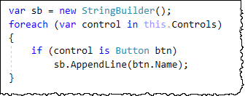
Defensive Tip #2: Avoid Type Cast
private void button1_Click(object sender, EventArgs e)
{
((Button)sender).Text = "You pressed a button";
Button button = sender as Button;
if (button != null)
{
button.Text = "You pressed a button";
}
}
Code that works and passes all tests
But is missing the Defense
Source: https://scottdorman.github.io/2008/07/04/what-is-ldquodefensive-programmingrdquo/

Slide 52
Defensive Tip #3: Log Files
… ‘nough said

Slide 53
Coding Standards: Checklist
Getting Started
Advanced Checklist
Naming Conventions
Editor Conventions
Code Stability and Robustness
Maintainability
Teams and Testing
Security
Error Handling / Logging
User Logging
Corporate Integration
Other
Source: Mark Reynolds, compilation

Slide 54
Closing Thoughts
A Foolish Consistency is the Hobgoblin of Little Minds
~ “Self-Reliance” by Ralph Waldo Emerson.

Slide 55

Mark Reynolds
Mark Reynolds Vitae
TBD
Southwestern Energy
Lone Star College
Intent Driven Designs
Scan Systems
Sikorsky Aircraft
General Dynamics
Personal Email: mark@DataDriven.Energy
Linkedin: www.linkedin.com/in/ProfReynolds
Twitter: @Prof_Reynolds
http://ProfReynolds.com

